Slide 1

Preparing for the Exam

Slide 2

Do I really need to Study?

Slide 3
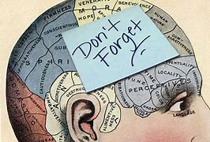
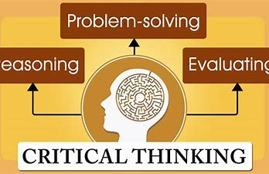
What is being evaluated?
Take-Home Exam

Slide 4
Study Tips
Take-Home Exam
Familiarise yourself with the key topics
Identify the key themes, theory and evidence
Prepare and organize texts and notes
Analyze the model answer
Take time to prepare

Slide 5
Taking the Exam
Analyze the question
Plan your response carefully using your notes and materials
Write your response and demonstrate your thinking
Revise your work

Slide 6


